Slide 1
Computer Graphics Project
Celestial Exploratory(Solar System)
Kumar Shivam Ranjan (18075031)
Neha Kumari (18074012)

Slide 2
OpenGL
OpenGL (Open Graphics Library) is a standard specification defining a cross language cross platform API for writing applications that produce 2D and 3D computer graphics.
The interface consists of over 250 different function calls which can be used to draw complex 3D scenes from simple primitives.

Slide 3
Project Goal
The aim of this project is to show the shadow implementation using OPENGL which include Movement, Light properties , and also transformation operations like translation, rotation,scaling etc on objects. The package must also have a user friendly interface .

Slide 4
Scope
The Project is developed in ECLIPSE. It has been implemented on UBUNTU platform.
The 3-D graphics package designed here provides an interface for the users for handling the display and manipulation of Celestial Exploratory.
The Keyboard is the main input device used.

Slide 5
Requirement Specification
HARDWARE REQUIREMENTS:
4GB of RAM, 2GB MB recommended.
110 MB of hard disk space required, 40 MB additional hard disk space required for installation (150 MB total).
SOFTWARE REQUIREMENTS:
Development Platform: LINUX (UBUNTU 20.04)
Language : C/C++
Tool : Eclipse
Library : OpenGL

Slide 6
Design
We have incorporated several inbuilt OpenGL function in this project.
The following code snippet enables the easy rendering of solid sphere with different colors and makes them to rotate and translate.
{
glRotatef(s. . .);
glTranslatef(. . .);
glRotatef(. . .);
glColor3f(. . .);
glutSolidSphere(. . .)
}

Slide 7
Design(2)
Header Files Used are:
#include<stdlib.h>: This is C library function for standard input and output.
#include<GL/glut.h>: This header is included to read the glut.h, gl.h and glu.h
#include<math.h>: This is a C library function for performing certain mathematical operations.

Slide 8
Design(3)
In the Init() we have made use of the following functions:
glClearColor(. . . ):
glshadeModel(. . .):
glEnable(. . .):
glMaterial(. . .):
glLight(. . .):
myinit();
glutMainLoop();

Slide 9
User Interface
Keyboard Based Interface
The keys m, v, e, r, j, s, u, n are used to rotate the planets.
The keys M, V, E, R, J, S, U, N are used to revolve the planets around the Sun.
The key z rotates the sun, B gives both the rotation and revolution of the planets around the rotating Sun with a Comet revolution and Stars twinkle.
Pressing the key A revolves all the planets and comet and the key a rotates all the planets around the rotating Sun with Stars twinkling in the background.
The key b is used to make the stars twinkle and c for the revolution of the Comet.

Slide 10
Mouse Interface
Left Button: Rotates and revolves the planets and Comet in anticlockwise direction.
Right Button: Rotates and revolves the planets and Comet in clockwise direction.

Slide 11
SnapShots
SnapShot1: In this snapshot ,sun is placed at the center and its eight planets are placed in the sun’s orbit.These eight planets are shown to be rotating and revolving around the sun. The planets and sun are placed in the background of bright twinkling stars.
SnapShot2: In this snapshot, we can see sun at the center and all eight planets revolving around the sun and are placed in the background of bright twinkling stars with the comet in a constant motion.

Slide 12
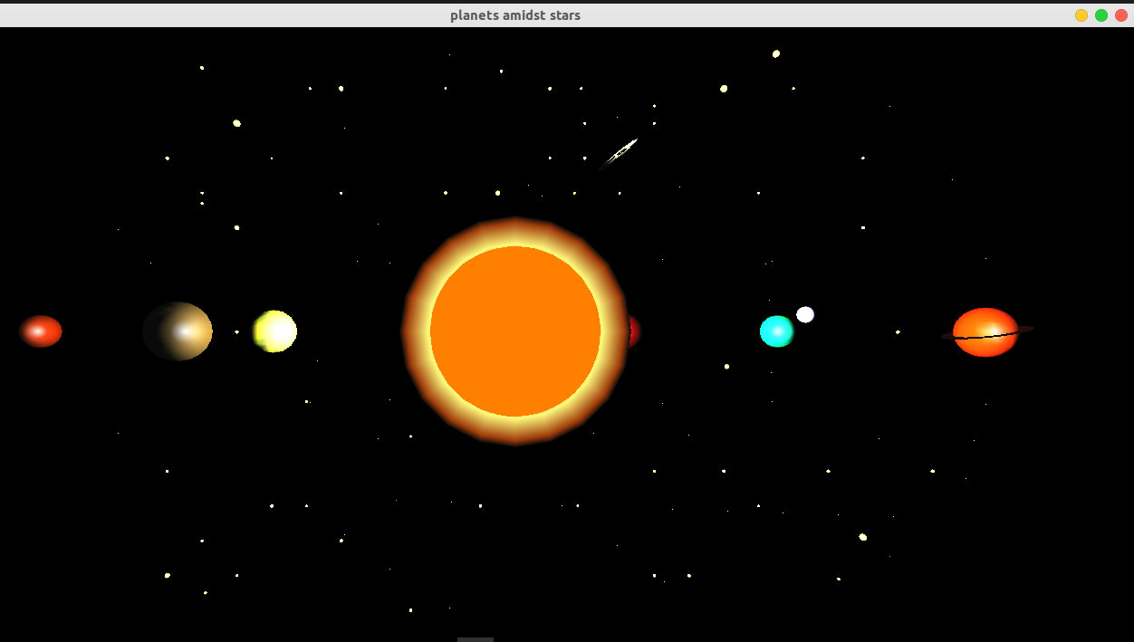

Slide 13
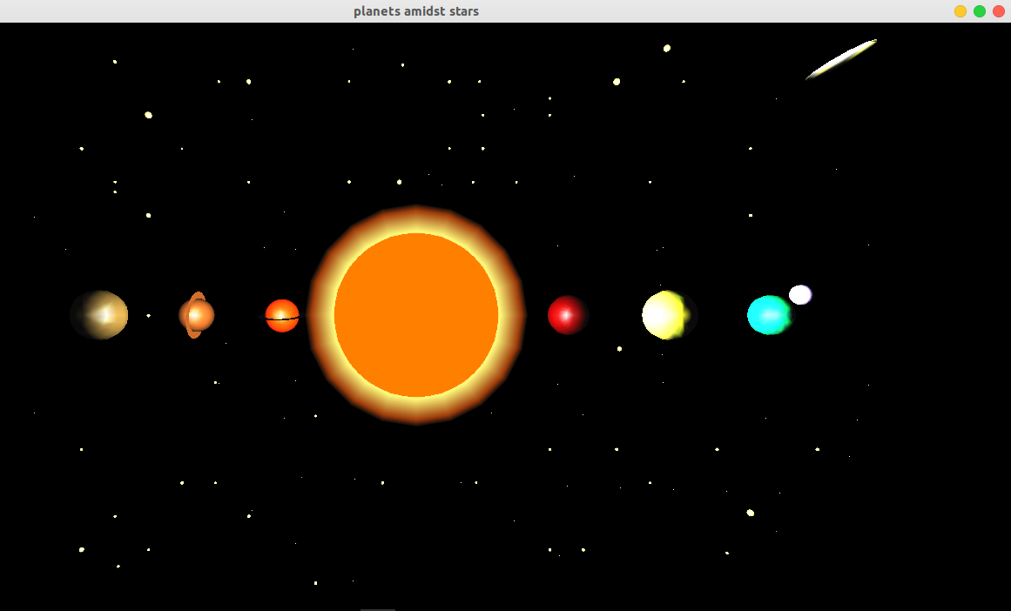

Slide 14
Thank You

